Slide 1

MODULE II
Understanding Requirements (Chapter 4)
Department of Computer Science and Engineering
School of Engineering, Presidency University

Slide 2
Module 2: Software Requirements and Design (9 hrs.) – Comprehension level
Requirements Engineering: Eliciting requirements, Functional and non- Functional requirements, SRS, Requirements modelling: Developing Use Cases, Developing Activity diagram and Swim lane diagram, Design : Design concepts, Architectural design, Component based design, User interface design.
Dept. of CSE, SOE, Presidency University

Slide 3
Contents
Requirements Engineering
1.1 Inception
1.2 Elicitation
1.3 Elaboration
1.4 Negotiation
1.5 Specification
1.6 Validation
1.7 Requirements Management
2. Establishing the ground work
3. Eliciting requirements
4. Developing Use-Case
5. Building the requirements model
6. Negotiating requirements
7. Validating requirements
Dept. of CSE, SOE, Presidency University

Slide 4
1. Requirements Engineering - I
Inception - ask a set of questions that establish …
  basic understanding of the problem
  the people who want a solution
  the nature of the solution that is desired, and
  the effectiveness of preliminary communication and collaboration between the customer and the developer
Elicitation - elicit requirements from all stakeholders
Elaboration - create an analysis model that identifies data, function and behavioral requirements
Negotiation - agree on a deliverable system that is realistic for developers and customers
Dept. of CSE, SOE, Presidency University

Slide 5
1. Requirements Engineering - I
5. Specification - can be any one (or more) of the following
  A written document
  A set of models
  A formal mathematical specification
  A collection of user scenarios (use-cases)
  A prototype
6. Validation - a review mechanism that looks for
  errors in content or interpretation
  areas where clarification may be required
  missing information
  inconsistencies (a major problem when large products or systems are engineered)
  conflicting or unrealistic (unachievable) requirements.
7. Requirements management
Dept. of CSE, SOE, Presidency University

Slide 6
Functional and Non functional Requirements
Functional Requirements
These are the requirements that the end user specifically demands as basic facilities that the system should offer.
All these functionalities need to be necessarily incorporated into the system as a part of the contract.
Non Functional Requirements
These are basically the quality constraints that the system must satisfy according to the project contract.
The priority or extent to which these factors are implemented varies from one project to other. They are also called non-behavioral requirements.
Dept. of CSE, SOE, Presidency University

Slide 7
FUNCTIONAL REQUIREMENTS | NON FUNCTIONAL REQUIREMENTS
1. A functional requirement defines a system or its component. | A non-functional requirement defines the quality attribute of a software system.
2. It specifies “What should the software system do?” | It places constraints on “How should the software system fulfill the functional requirements?”
3. Functional requirement is specified by User. | Non-functional requirement is specified by technical peoples e.g. Architect, Technical leaders and software developers.
4. It is mandatory. | It is not mandatory.
5. It is captured in use case. | It is captured as a quality attribute.
6. Defined at a component level. | Applied to a system as a whole.
7. Helps you verify the functionality of the software. | Helps you to verify the performance of the software.
8. Functional Testing like System, Integration, End to End, API testing, etc are done. | Non-Functional Testing like Performance, Stress, Usability, Security testing, etc are done.
9. Usually easy to define. | Usually more difficult to define.
Dept. of CSE, SOE, Presidency University

Slide 8
Software Requirements Specification
A software requirements specification (SRS) is a document that is created when a detailed description of all aspects of the software to be built must be specified before the project is to commence.
It is important to note that a formal SRS is not always written
Introduction
1.1 Purpose
1.2 Document Conventions
1.3 Intended Audience and Reading Suggestions
1.4 Project Scope
1.5 References
2. Overall Description
2.1 Product Perspective
2.2 Product Features
2.3 User Classes and Characteristics
2.4 Operating Environment
Dept. of CSE, SOE, Presidency University

Slide 9
2.5 Design and Implementation Constraints
2.6 User Documentation
2.7 Assumptions and Dependencies
3. System Features
3.1 System Feature 1
3.2 System Feature 2 (and so on)
4. External Interface Requirements
4.1 User Interfaces
4.2 Hardware Interfaces
4.3 Software Interfaces
4.4 Communications Interfaces
5. Other Nonfunctional Requirements
5.1 Performance Requirements
5.2 Safety Requirements
5.3 Security Requirements
5.4 Software Quality Attributes
6. Other Requirements
Dept. of CSE, SOE, Presidency University

Slide 10
2. Establishing the ground work
Identify stakeholders
  “who else do you think I should talk to?”
Recognize multiple points of view
Work toward collaboration
The first questions
  Who is behind the request for this work?
  Who will use the solution?
  What will be the economic benefit of a successful solution
  Is there another source for the solution that you need?
Dept. of CSE, SOE, Presidency University

Slide 11
3. Eliciting Requirements
3.1 Collaborative Requirements Gathering
meetings are conducted and attended by both software engineers and customers
rules for preparation and participation are established
an agenda is suggested
a "facilitator" (can be a customer, a developer, or an outsider) controls the meeting
a "definition mechanism" (can be work sheets, flip charts, or wall stickers or an electronic bulletin board, chat room or virtual forum) is used
the goal is
  to identify the problem
  propose elements of the solution
  negotiate different approaches, and
  specify a preliminary set of solution requirements
Dept. of CSE, SOE, Presidency University

Slide 12
3.2 Quality Function Deployment
Normal requirements: Requirements which are stated during the meeting with the customer
Example:) normal requirements might be requested types of graphical displays, specific system functions
Expected requirements: Requirements are implicit to the product or system that are not explicitly stated by the customer.
Exciting requirements: features go beyond the customer’s expectations and prove to be very satisfying when present.
Example:) software for a new mobile phone comes with standard features, but is coupled with a set of unexpected capabilities (e.g., multitouch screen, visual voice mail) that delight every user of the product.
3.3 Usage Scenarios
3.4 Elicitation Work Products
Dept. of CSE, SOE, Presidency University

Slide 13


4. Developing use cases
Use Case Methodology (UCM) (for Requirements Elicitation)
Key Terms in UCM
SUD – System under Discussion
Actor
Actors are basically users of the SUD who are external entities (people or other systems) who interact with the SUD to achieve a desired goal. Actors are represented as stick figures.
Types of Actors:
  Primary Actor
  The Actor(s) using the system to achieve a goal.
  Secondary Actor
  Actors that the system needs assistance from to achieve the primary actors goal.
Use Case
A use case is a collection of possible sequences of interactions between the SUD and its Actors, relating to a particular goal. The collection of Use Cases should define all system behavior relevant to the actors to assure them that their goals will be carried out properly.
A use case is drawn as a horizontal ellipse.
Dept. of CSE, SOE, Presidency University

Slide 14
Key Terms in UCM
Use Cases:
Hold Functional Requirements in an easy to read, easy to track text format.
Represents the goal of an interaction between an actor and the system. The goal represents a meaningful and measurable objective for the actor.
Records a set of paths (scenarios) that traverse an actor from a trigger event (start of the use case) to the goal (success scenarios).
Records a set of scenarios that traverse an actor from a trigger event toward a goal but fall short of the goal (failure scenarios).
Are multi-level: one use case can use/extend the functionality of another.
Use Case Names Begin With a Strong Verb
Use Cases are named using the domain terminologies
Use Cases Do Not…
Specify user interface design. They specify the intent, not the action detail
Mock up screens/ Prototype may be included depicting the functionality
Specify implementation detail (unless it is of particular importance to the actor to be assured that the goal is properly met)
Dept. of CSE, SOE, Presidency University

Slide 15
Key Terms in UCM
Use Case Relationships (Associations)
Associations between actors and use cases are indicated in use case diagrams by solid lines. An association exists whenever an actor is involved with an interaction described by a use case.
There are several types of relationships that may appear on a use case diagram:
An association between an actor and a use case
An association between two use cases
A generalization between two actors
A generalization between two use cases
Dept. of CSE, SOE, Presidency University

Slide 16
Key Terms in UCM
Includes Relationship
"X includes Y" indicates that the task "X" has a subtask "Y"; that is, in the process of completing task "X", task "Y" will be completed at least once.
Extends Relationship
"X extends Y" indicates that "X" is a task of the same type as "Y", but "X" is a special, more specific case of doing "Y". That is, doing X is a lot like doing Y, but X has a few extra processes to it that go above and beyond the things that must be done in order to complete Y.
Dept. of CSE, SOE, Presidency University

Slide 17
Key Terms in UCM
Use Case Diagram
A use case diagram shows the relationships among actors and use cases within a SUD.
Use Case Model
A use case model is comprised of one or more use case diagrams and any supporting documentation such as use case specifications and actor definitions. Within most use case models the use case specifications tend to be the primary artifact with use case diagrams filling a supporting role as the “glue” that keeps the requirements model together.
Dept. of CSE, SOE, Presidency University

Slide 18
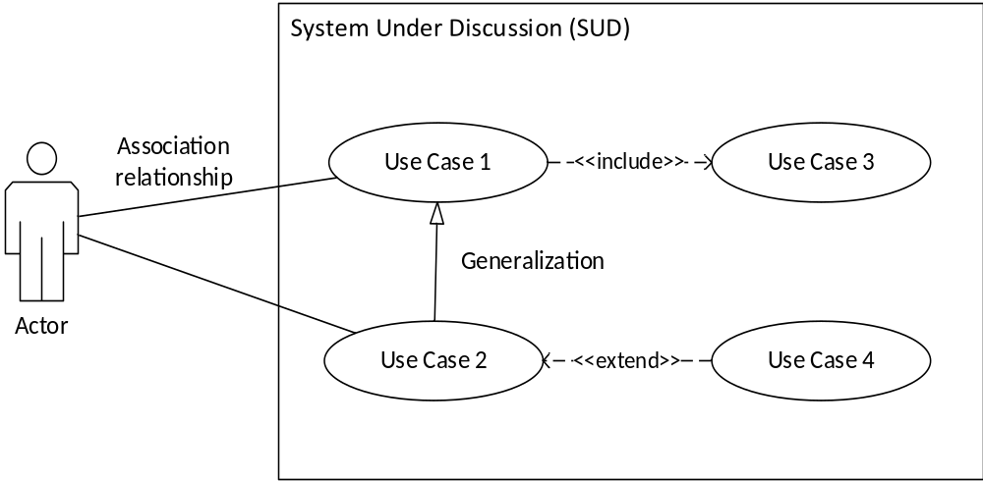
Use Case Diagram
Dept. of CSE, SOE, Presidency University

Slide 19
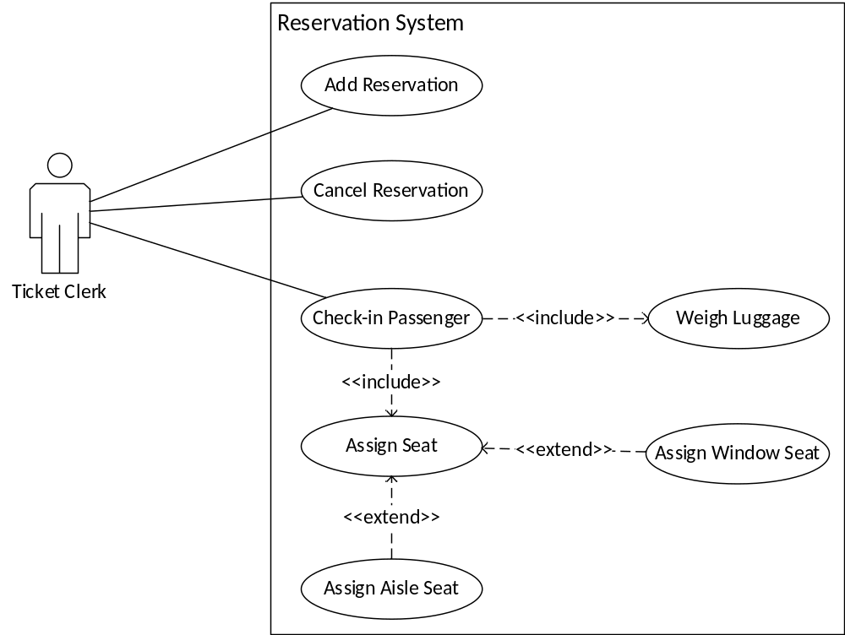
Use Case Diagram
Airline Reservation System
Dept. of CSE, SOE, Presidency University

Slide 20
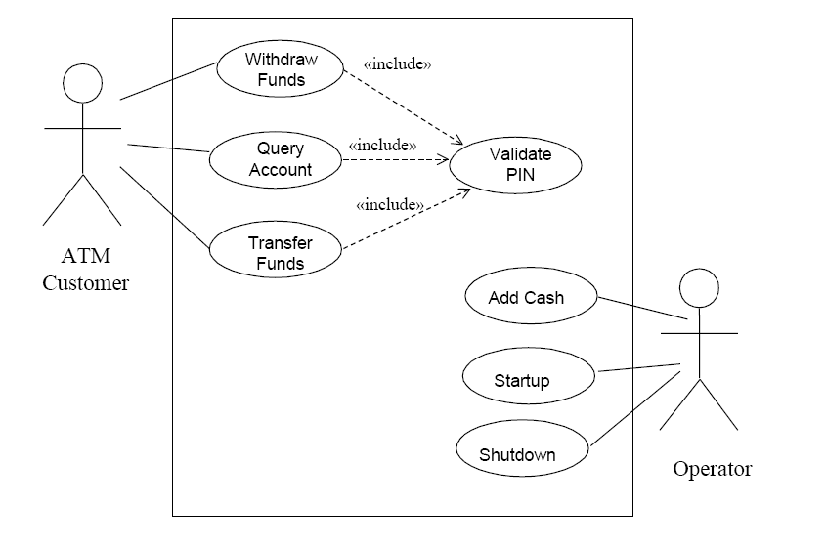
Use Case Diagram
ATM Transaction
Dept. of CSE, SOE, Presidency University

Slide 21
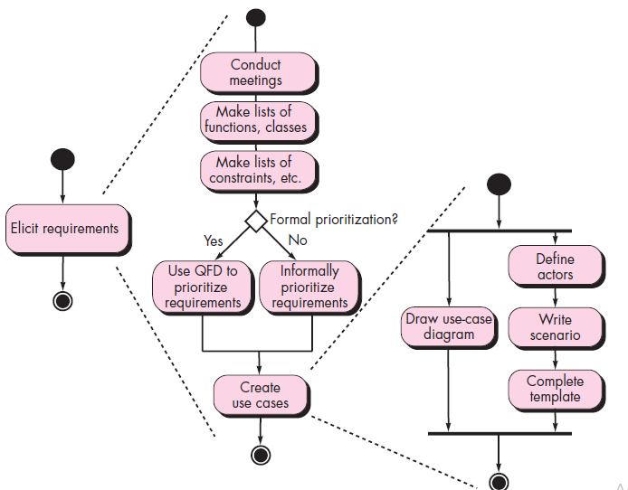
5. Building the Requirements Model
Activity Diagram for Eliciting Requirements
Dept. of CSE, SOE, Presidency University

Slide 22
Elements
Scenario based elements
Class based elements
Behavioral elements
Flow – oriented elements
Analysis Patterns
suggest solutions (e.g., a class, a function, a behavior) within the application domain that can be reused when modeling many applications.
Dept. of CSE, SOE, Presidency University

Slide 23
6. Negotiating Requirements
Identify the key stakeholders
  These are the people who will be involved in the negotiation
Determine each of the stakeholders “win conditions”
  Win conditions are not always obvious
Negotiate
  Work toward a set of requirements that lead to “win-win”
Dept. of CSE, SOE, Presidency University

Slide 24
7. Validating Requirements - I
Is each requirement consistent with the overall objective for the system/product?
Have all requirements been specified at the proper level of abstraction? That is, do some requirements provide a level of technical detail that is inappropriate at this stage?
Is the requirement really necessary or does it represent an add-on feature that may not be essential to the objective of the system?
Is each requirement bounded and unambiguous?
Does each requirement have attribution? That is, is a source (generally, a specific individual) noted for each requirement?
Do any requirements conflict with other requirements?
Dept. of CSE, SOE, Presidency University

Slide 25
Validating Requirements - I
Is each requirement achievable in the technical environment that will house the system or product?
Is each requirement testable, once implemented?
Does the requirements model properly reflect the information, function and behavior of the system to be built.
Has the requirements model been “partitioned” in a way that exposes progressively more detailed information about the system.
Have requirements patterns been used to simplify the requirements model. Have all patterns been properly validated? Are all patterns consistent with customer requirements?
Dept. of CSE, SOE, Presidency University

